Slide 1
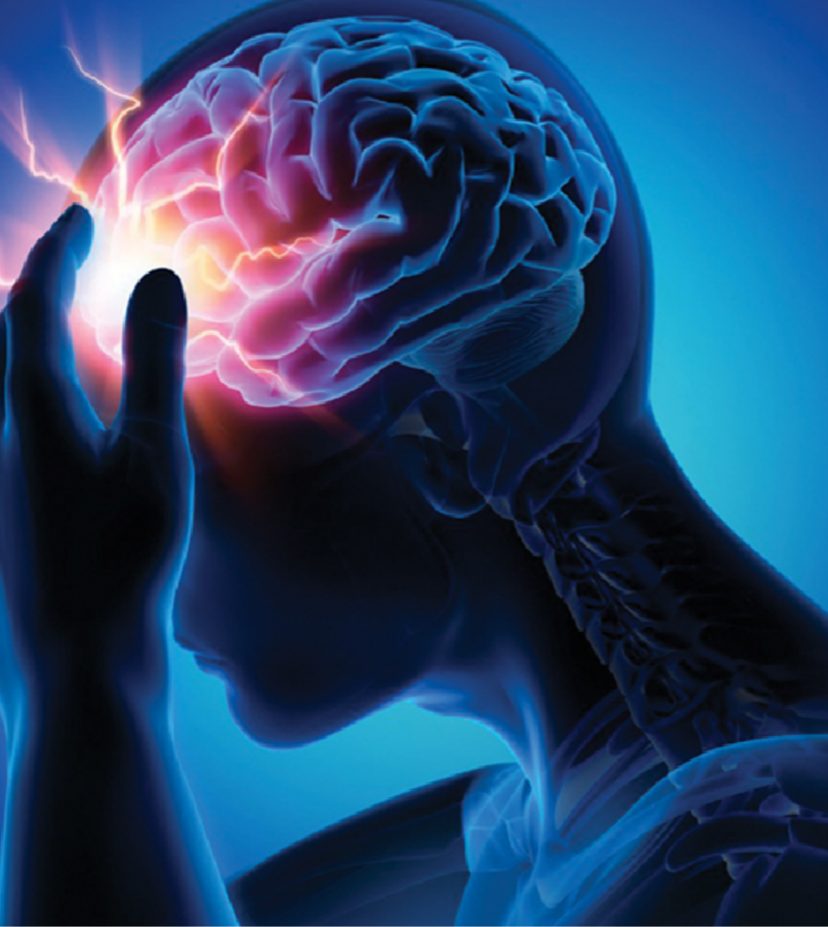
Title : Synthetic Minority Oversampling Technique: Predicting brain stroke in younger to middle-aged adults.
Group 5 :
Pallavi Vaswani Veena Upadhye
Geetaharichandana Vemuri Venkata Siva Rao Kamisetty Sreevidhya P V Venkataramana Pittala

Slide 2
Introduction
Background:
The dataset has information related to Cerebral Stroke with 43400 rows and 12 columns.
The data is arranged in a way where multiple values can be retrieved using a primary key like id and no column is allowed to be empty as we have used the "not null" condition for the id column.
It is a record of the dataset where data can be analyzed on basis of gender, previous health condition, and the mentioned comments.
It supports various data types like an integer for id, varchar for names, decimal for point values, and Boolean.

Slide 3
Aim: Predicting the possibility of cerebrovascular accident occurrence in the age group below 60 years by analyzing variables like gender, smoking status, hypertension, previous conditions, work status, and residence type and using the Synthetic Minority Over-sampling Technique (SMOTE) to balance the dataset.
Purpose: To predict the occurrence of stroke based on the factors such as smoking status, age, BMI, hypertension, and heart disease.

Slide 4
Project Hypothesis
Null hypothesis: The reason for stroke among the age group lower than 60 is not relevant to the variables in the dataset.
Alternate hypothesis: The reason for stroke among the age group lower than 60 is associated with the
variables in the dataset.

Slide 5
Methodology
Data collection: “Cerebral Stroke Prediction- Imbalanced Dataset” (Liu et al., 2019), obtained from:
https://www.kaggle.com/datasets/shashwatwork/cerebral-stroke-predictionimbalaced- dataset
Data storage: CSV file
Data extraction, description:
Correlation between the occurrence of stroke for the age group below 60 years.

Slide 6


Data Cleaning

Slide 7

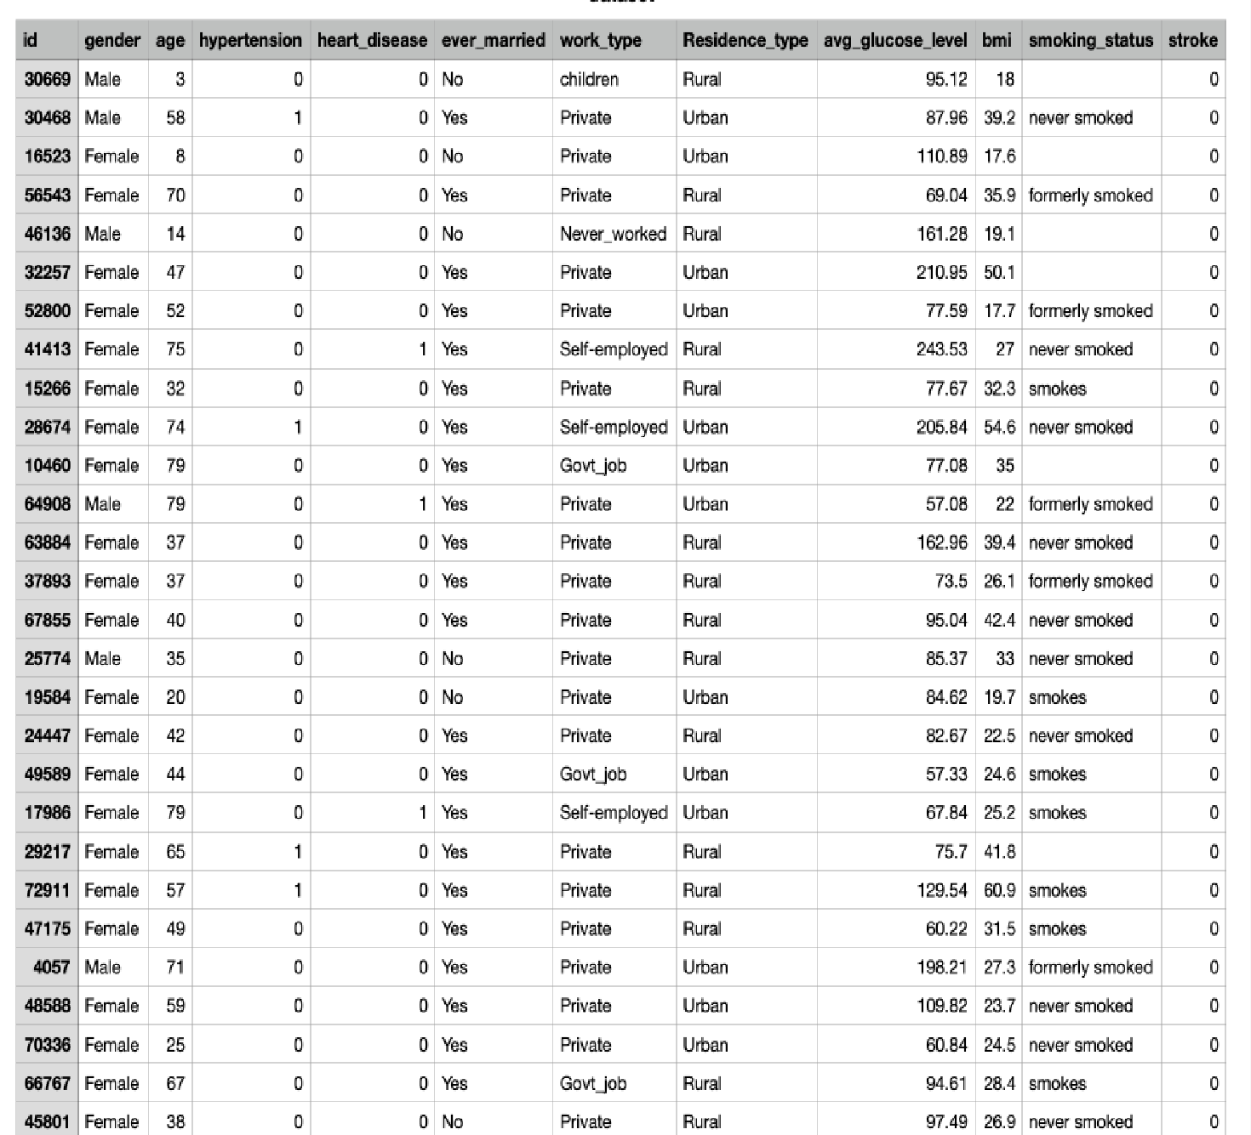
Raw data in Excel : Containing 43400 rows and 12 columns

Slide 8
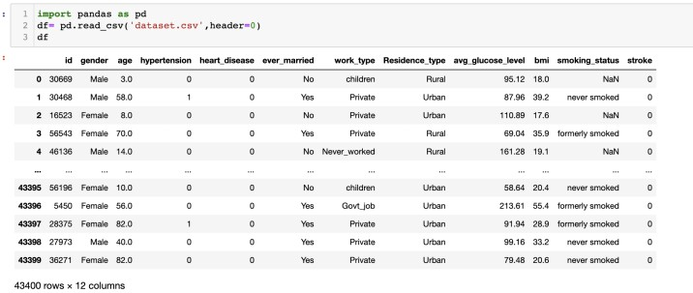
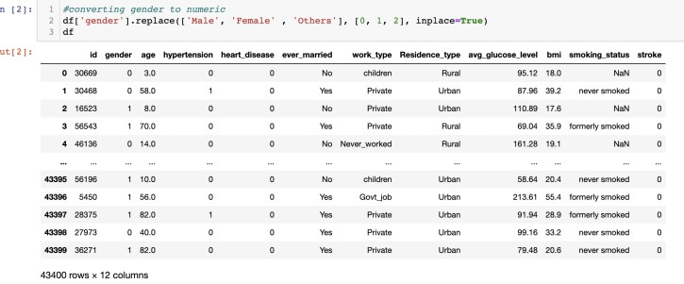
Reading the dataset
Converting gender to numeric
Likewise, we have also converted the other columns like age, hypertension, heart disease, ever married, work type, smoking status and residence type.

Slide 9
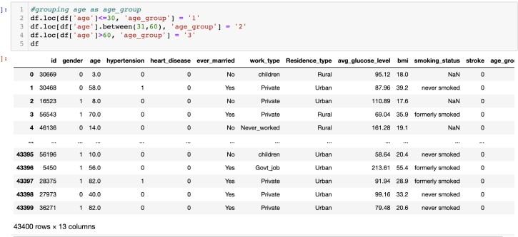

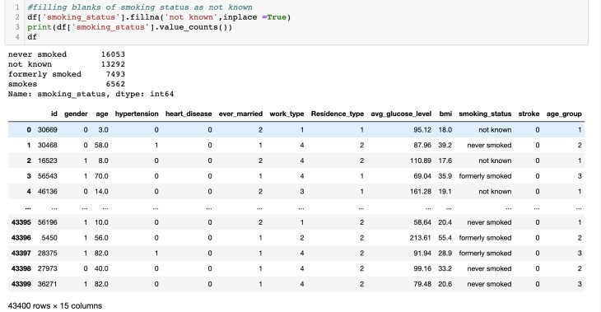
 |  |  | Grouping | age as | age gro | up
 |  | Filli | ng blanks | of smoki | ng status | as not kno | wn

Slide 10

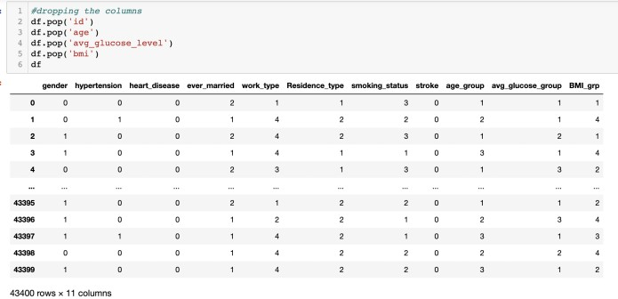
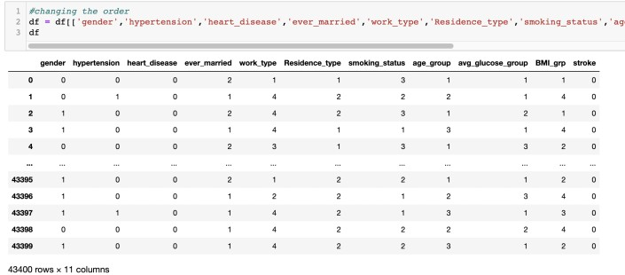
 |  |  | Dro | pping th | e columns
 |  |  |  |  |  |  |  |  | Chang | ing the | order

Slide 11

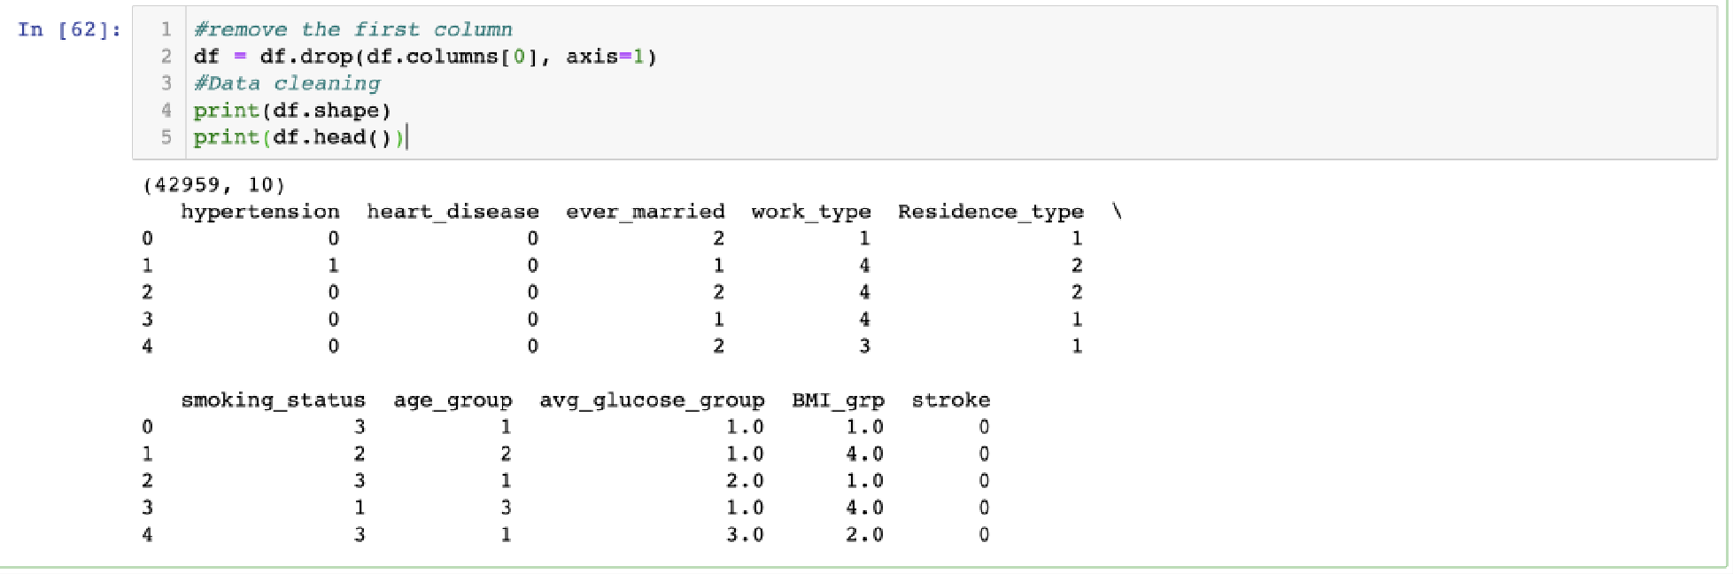

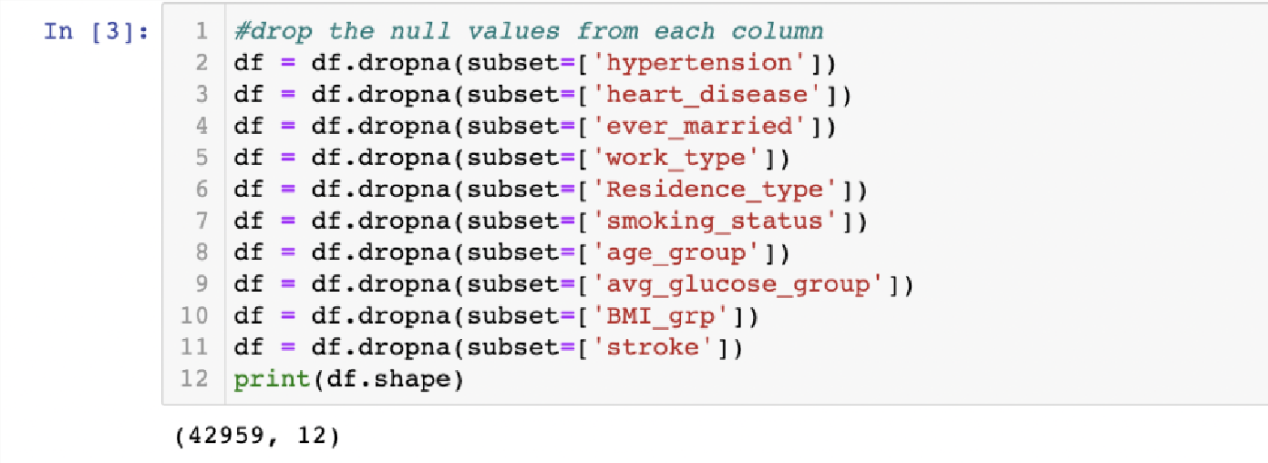
 |  | Drop | ping the | null valu | es from th | e column
 |  |  |  |  |  |  |  |  | After colum | dropping th n, there are | e null valu 42959 row | es from th s and 12 | e
 |  |  |  |  |  |  |  |  | colum | ns.

Slide 12


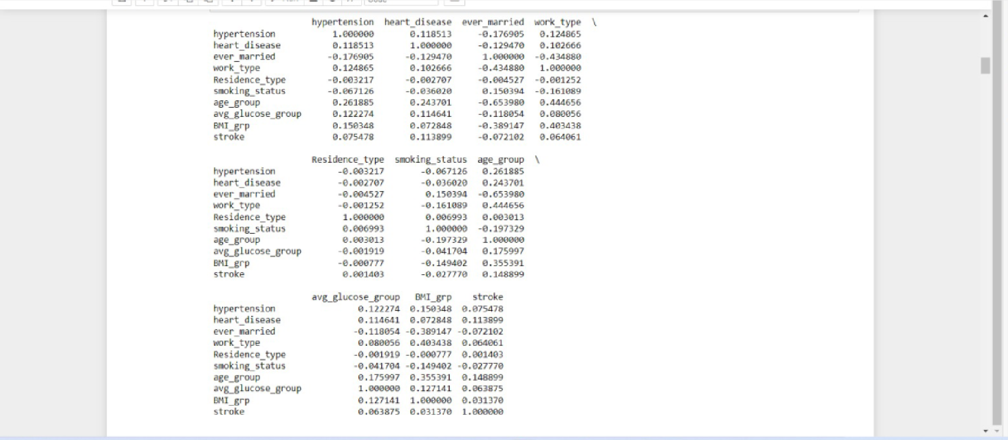
 |  |  |  |  |  | Correl | ation ma | trix

Slide 13
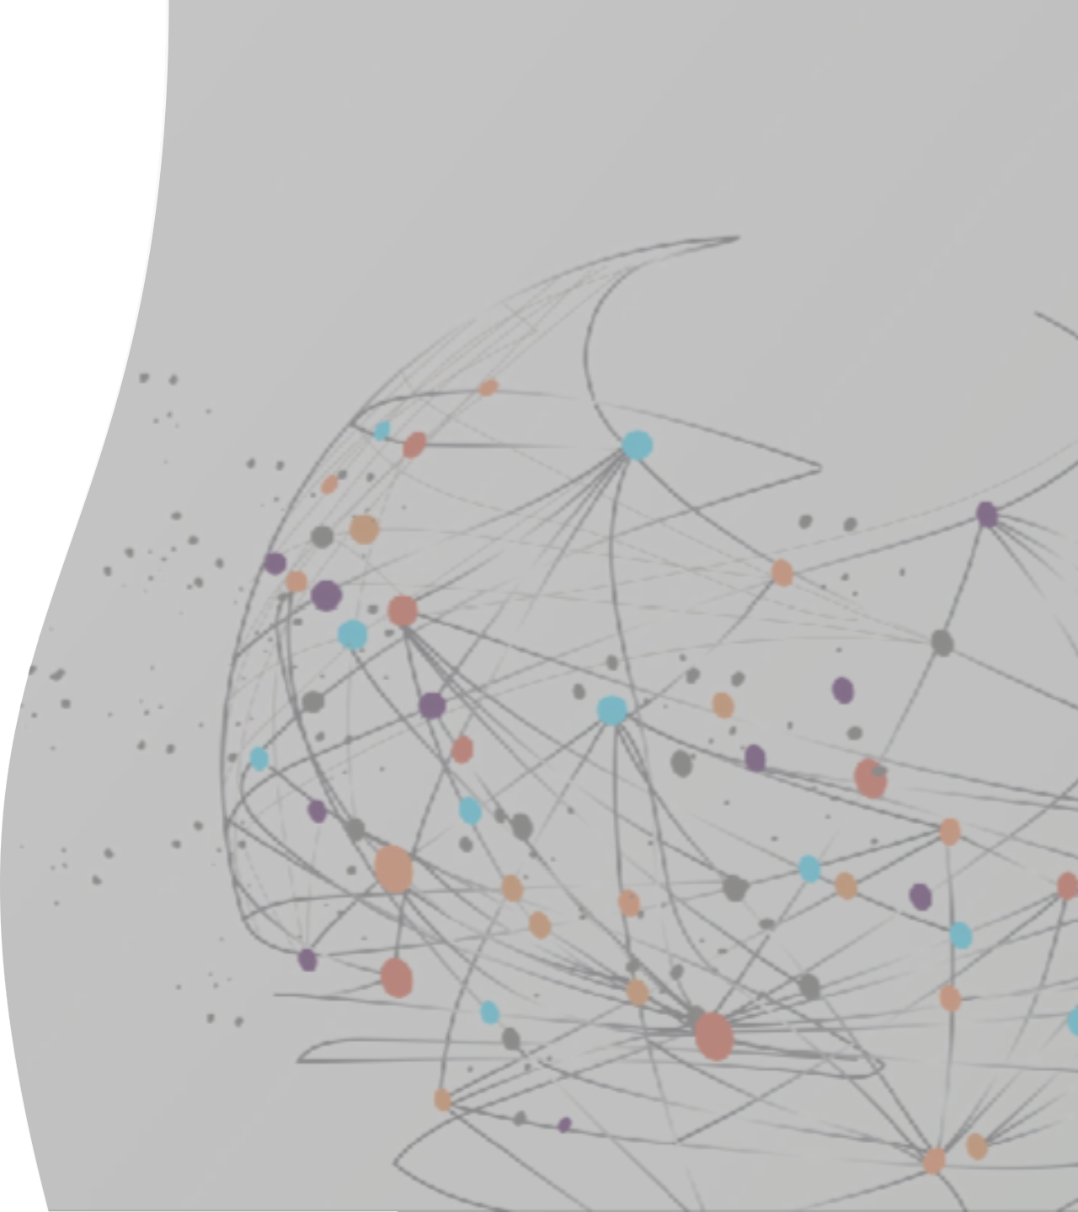
Data Visualization

Slide 14
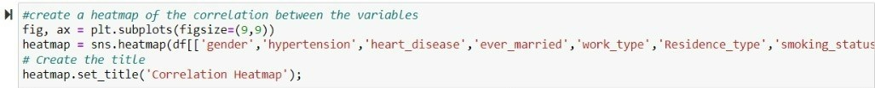
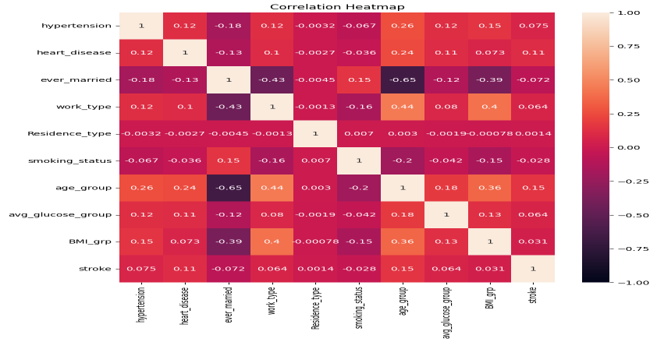
Visualization code for Heat map comparing Stroke with Hypertension, Heart disease, ever married, Work type, Residence type, Smoking status, Age group, Average glucose group, BMI group
The heat map shows, that age group (0.15) is highly positively correlated to stroke and smoking status (-0.28) is highly negatively correlated with stroke

Slide 15


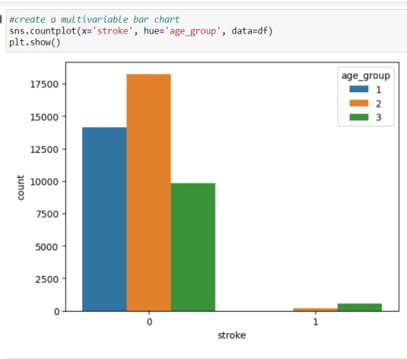
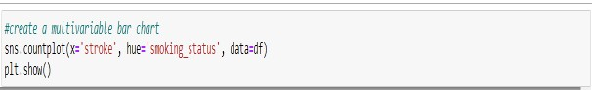

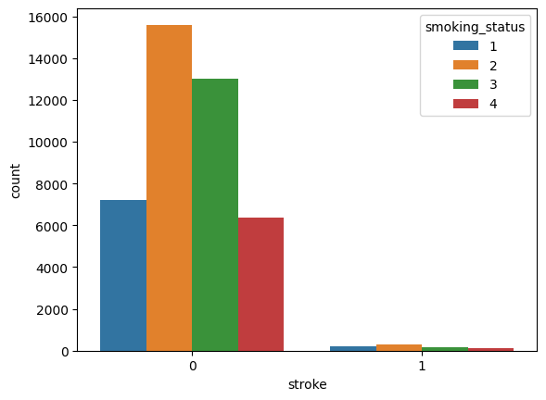
Multivariable Bar chart with correlated values as shown in Heat map
We can infer that stroke values(1) are very less than the non-stroke value (0) which means that the Dataset is imbalanced.

Slide 16

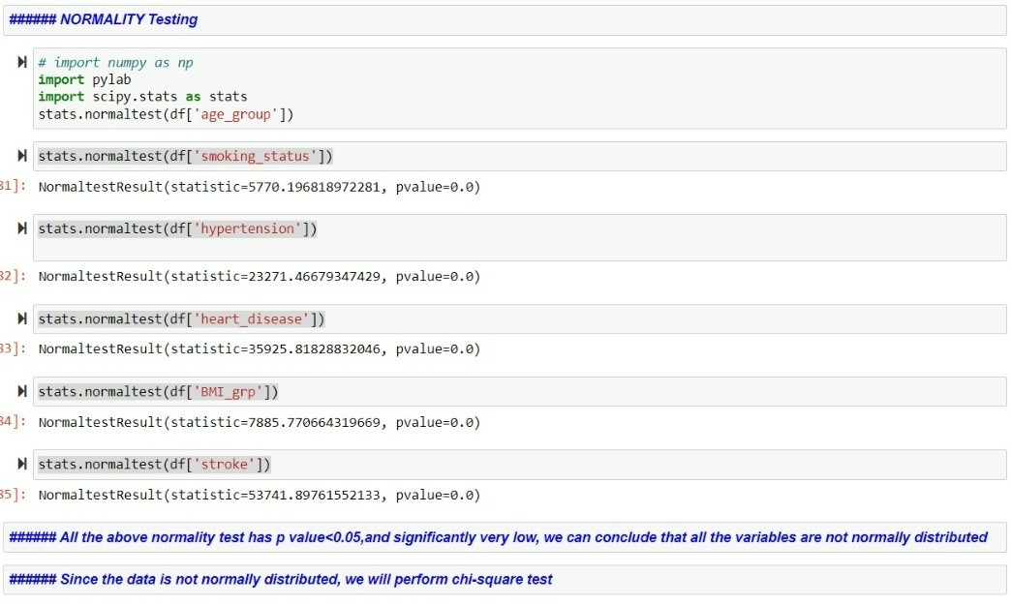
Normality testing

Slide 17

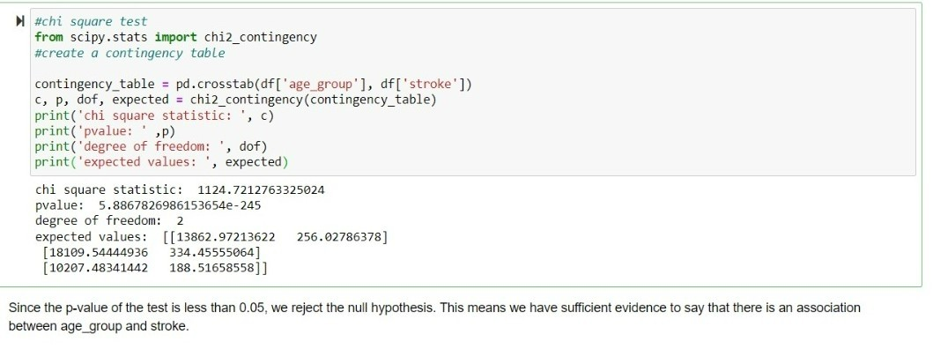
 |  | Chi-s | quare tes | t with age | group and | stroke

Slide 18
-Logistic Regression
M L Models
-LASSO (Least Absolute shrinkage and selection operator)
-KNN classification

Slide 19

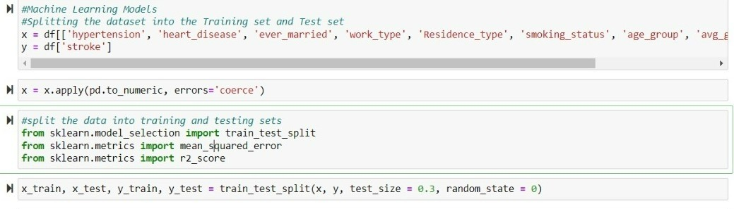
Splitting the data set:
Here, the training and testing data are divided at a ratio of 70 to 30.

Slide 20


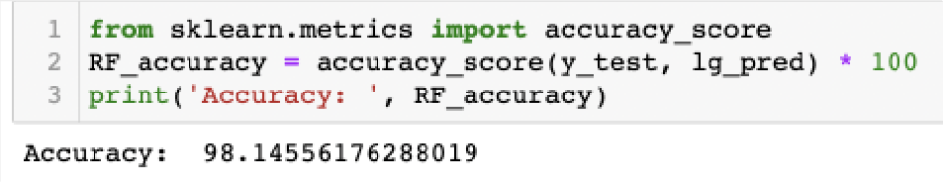

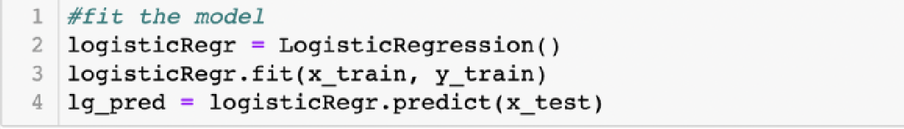

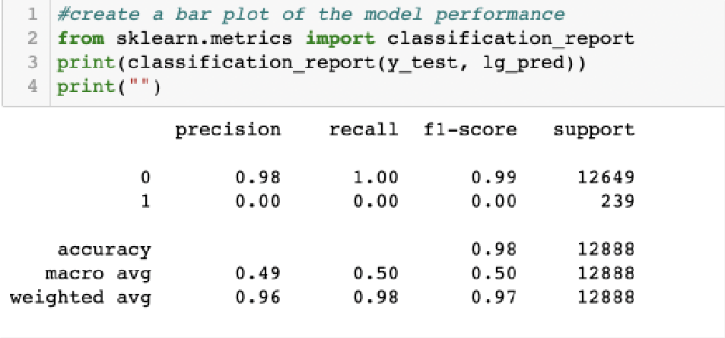

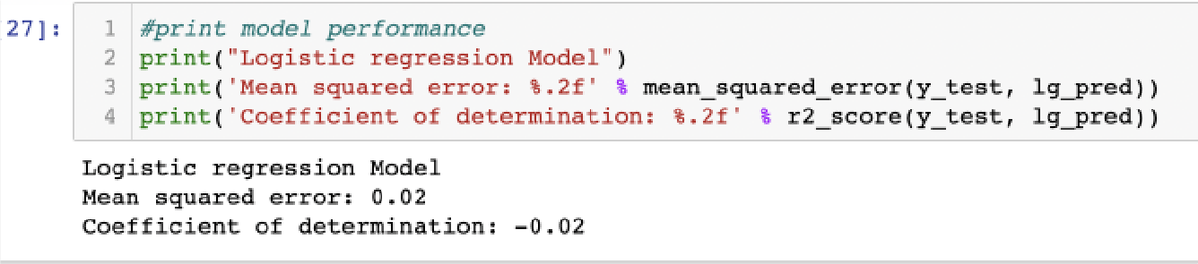
Logistic Regression

Slide 21

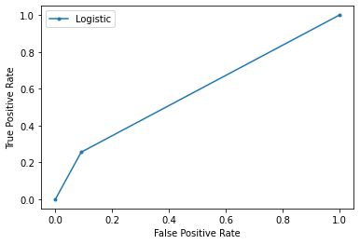
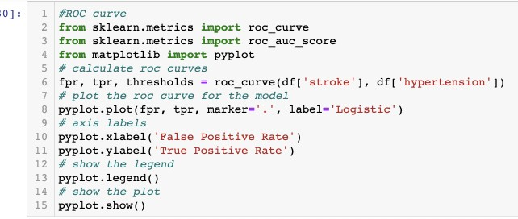
ROC Curve

Slide 22

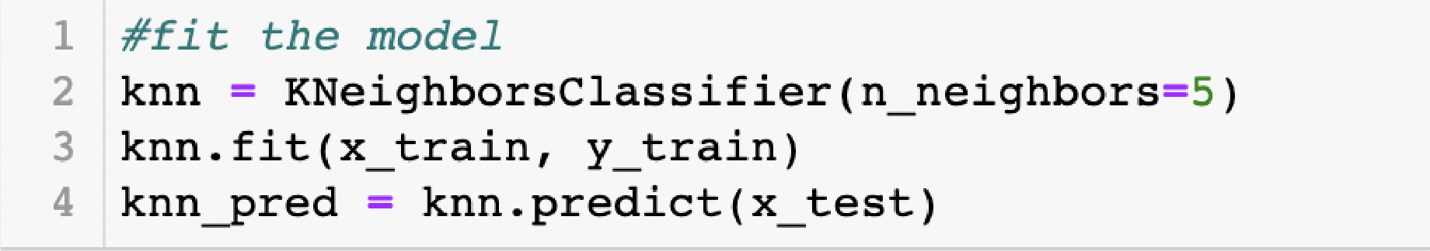

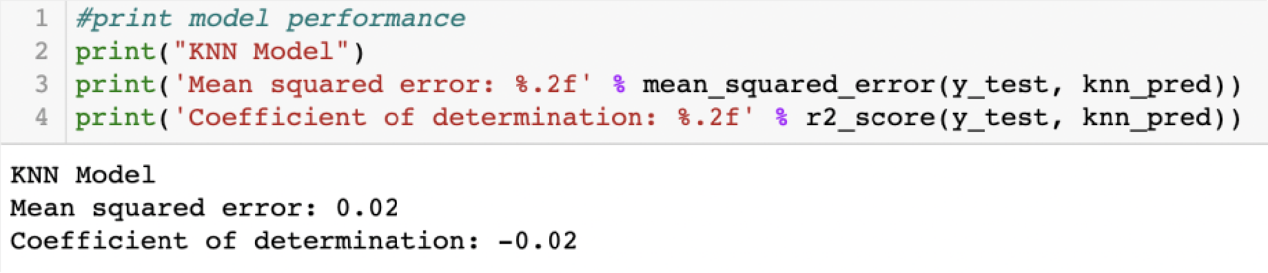

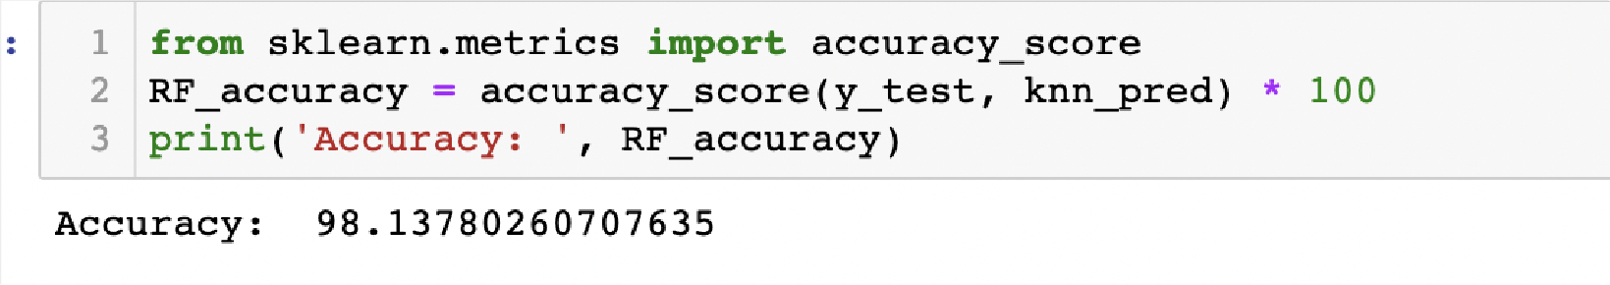
KNN classification

Slide 23

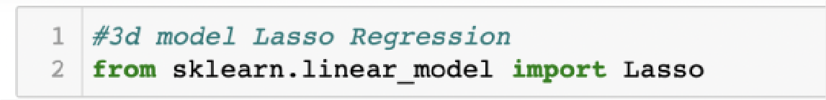

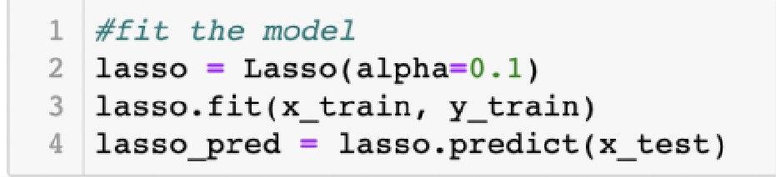

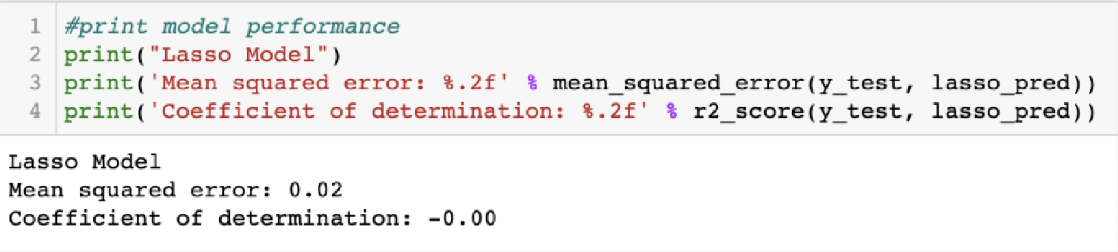
Lasso Regression (Least Absolute Shrinkage and Selection Operation)

Slide 24
Reason for applying SMOTE to the data
Our data set is imbalanced with too many non-stroke cases and very few stroke cases.
Imbalanced data set will make the model more prone to majority cases and will give biased results.
In logistic regression the accuracy is 0.98 because it is oriented toward non-stroke cases.
The coefficient of determination in KNN classification is a negative value, which portrays that there is no direct correlation between the variables and the occurrence of stroke ( because of imbalanced data)

Slide 25

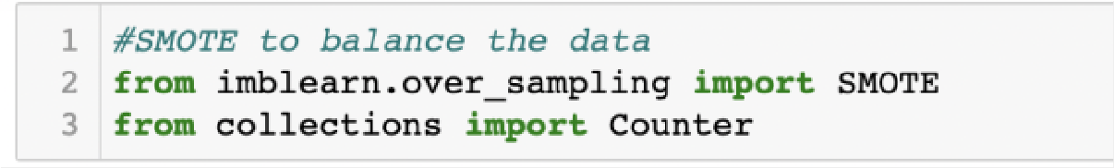

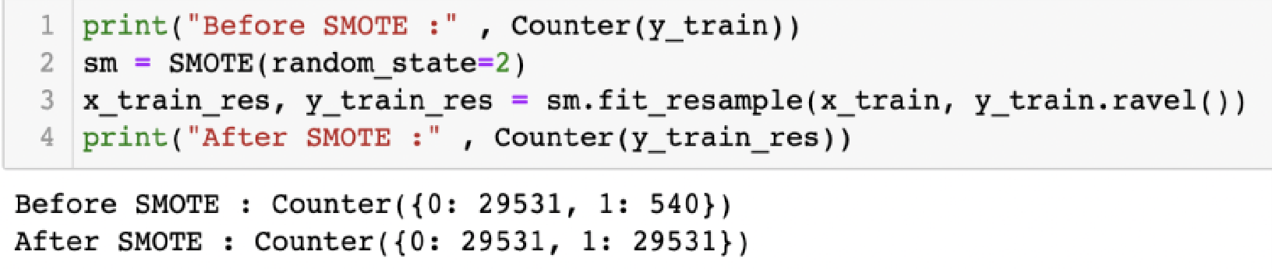

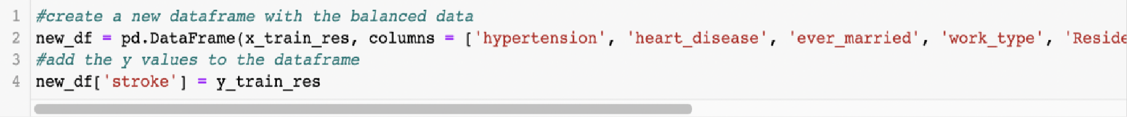
Using SMOTE to balance the data
Now the data set is balanced with: After SMOTE: Counter (0:29531, 1:540)

Slide 26

Data Visualization after SMOTE

Slide 27
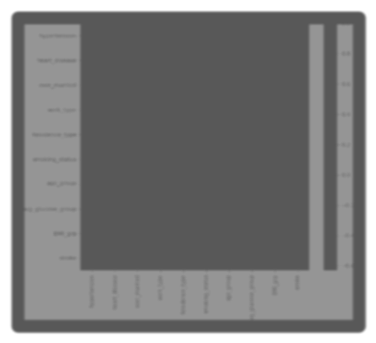

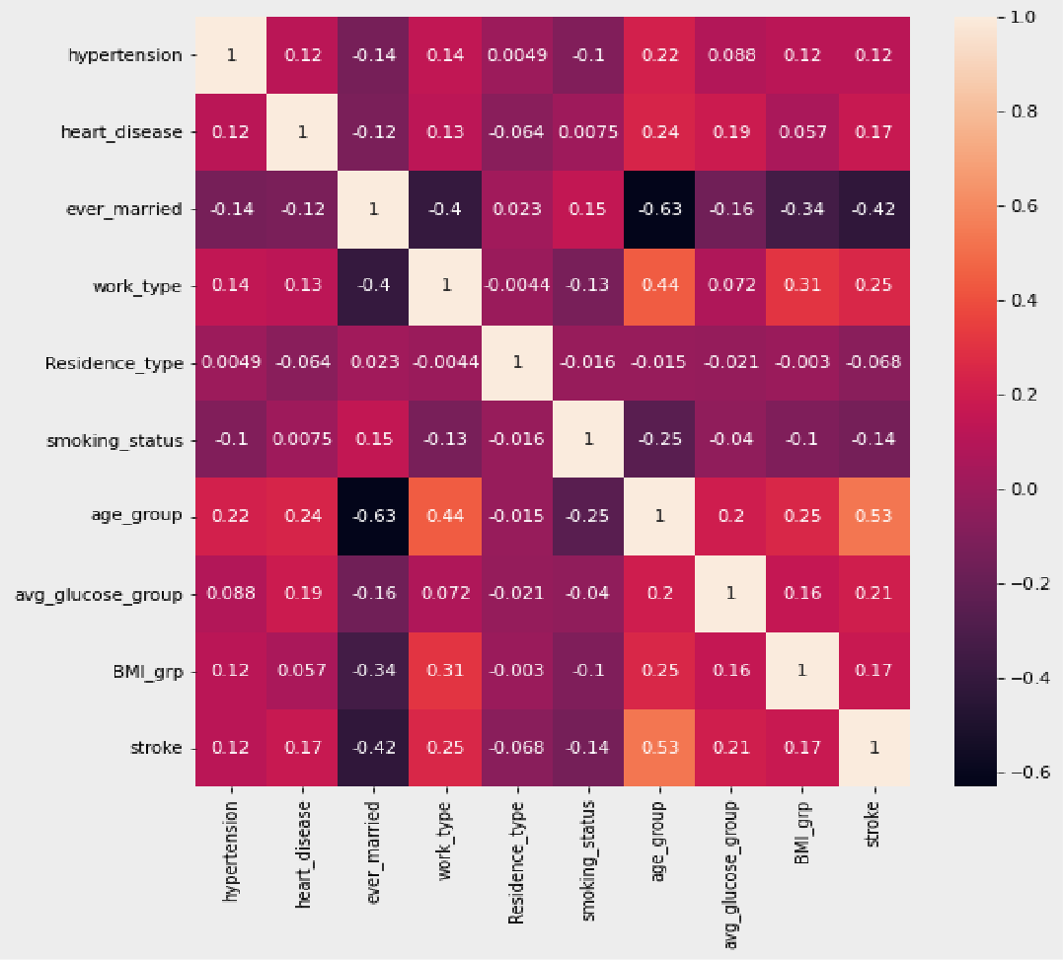
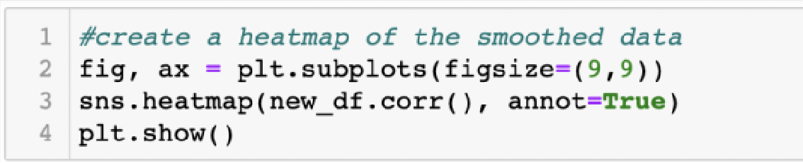
Correlation Heatmap After SMOTE
According to the Heat map constructed after SMOTE, Hypertension, work type, and age group are positively correlated, and smoking status is negatively correlated.

Slide 28
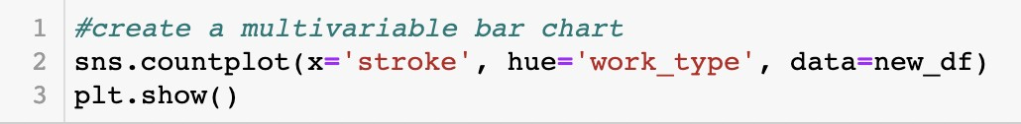
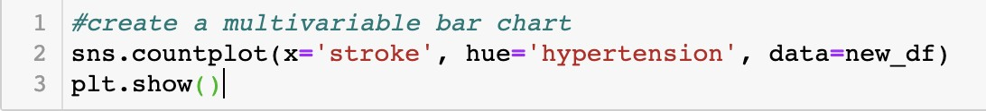
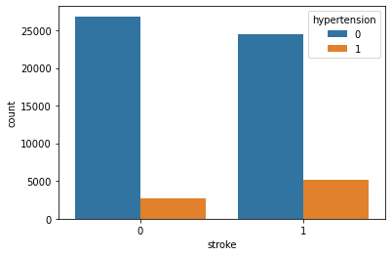
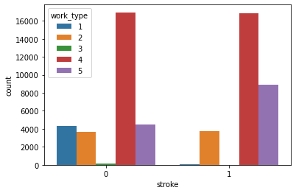
Multivariable Bar Chart After SMOTE

Slide 29
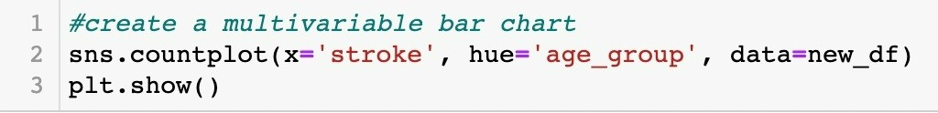
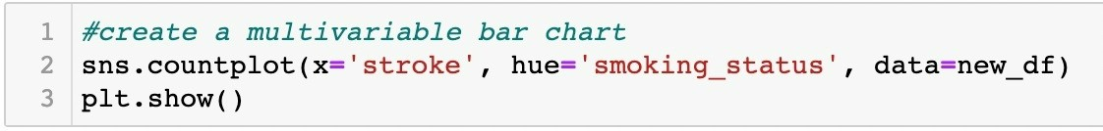
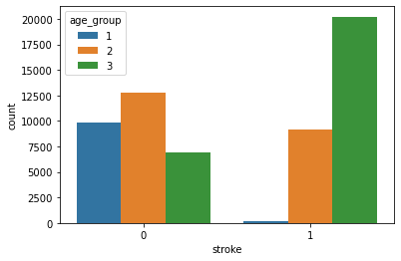
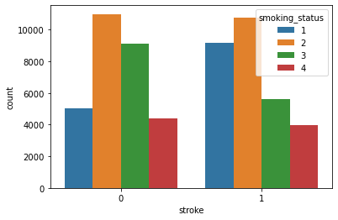
Multivariable Bar Chart after SMOTE

Slide 30

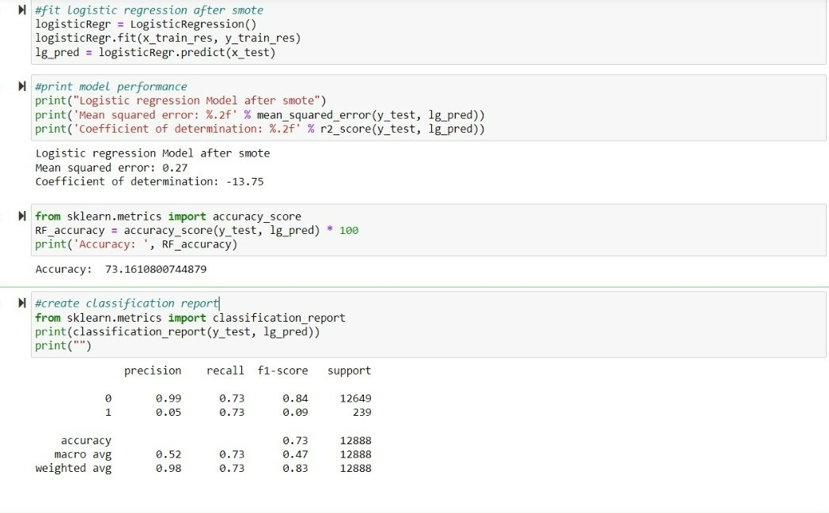
 |  | Log | istic Re | gression | after S | MOTE

Slide 31


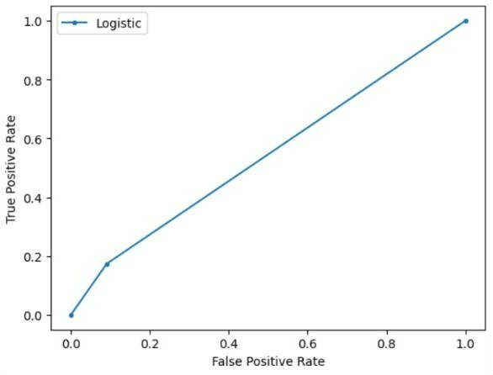
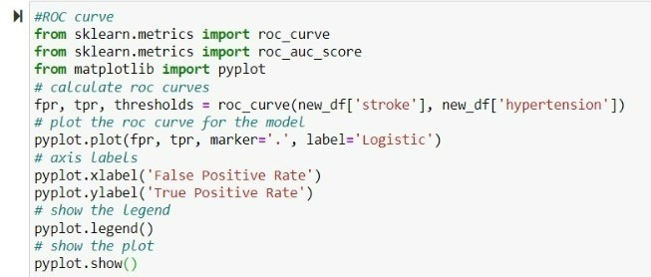
Receiver Operating Characteristic Curve (ROC) after SMOTE

Slide 32
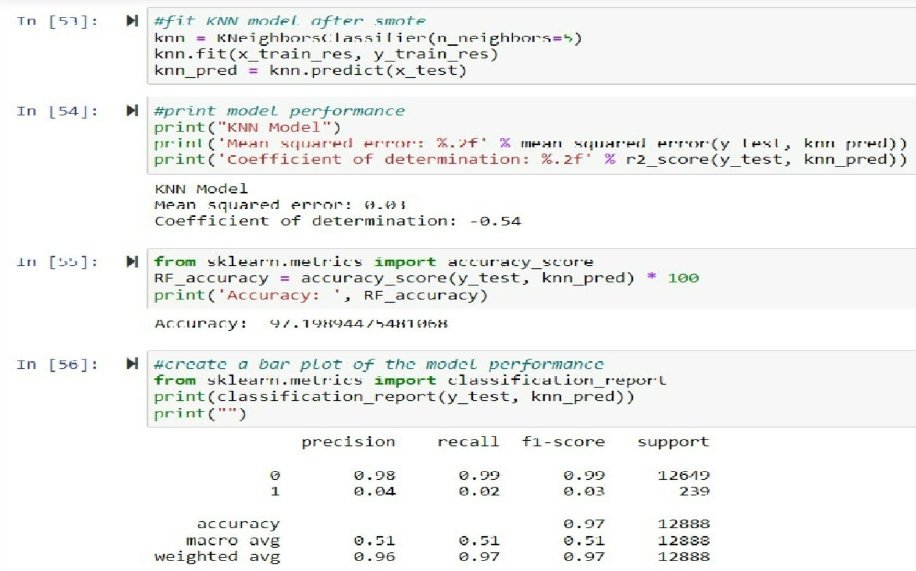
KNN Classification

Slide 33


LASSO Regression model after SMOTE

Slide 34


 | Test | ing | the Hyp | othesi | s

Slide 35
Results:
Interpretation of machine learning models before and after applying SMOTE.
Coefficient of determination has been reduced more negatively than before, in logistic regression, KNN classification, and LASSO.
Since the P value is less than 0.05 the null hypothesis is rejected.
The reason for stroke among the age group lower than 60 is relevant to the variables in the dataset

Slide 36
Limitations:
The dataset is not proportionate with many non-stroke cases and fewer stroke cases.
Medically smoking status affects the occurrence of stroke, but according to heat maps, it has a negative correlation.
Imbalanced data set will make the model more prone to majority cases and which results in bias.
The accuracy of the model decreased after applying SMOTE which usually occurs but even the R^2 value decreased which should not happen.
The coefficient of determination is more negative after applying smote which tells the model is not performing well even after applying SMOTE.

Slide 37


Appendix

Slide 38
 |  |  |  |  |  |  |  |  | The | append | ix include | s all the
 |  |  |  |  |  |  |  |  | co the | des which project. | have bee | n used in

Slide 39



Slide 40



Slide 41



Slide 42



Slide 43



